Slide 1
Artificial Intelligence for Security
Master Degree in Computer Science
curriculum in Security Engineering
Project
A.A. 2021/2022
Student: Giovanni Forleo

Slide 2

INTRODUCTION
A Distributed Denial of Service (DDoS) attack is a menace to network security that aims at exhausting the target networks with malicious traffic.
Monitoring Internet network traffic and analyze the data with artificial intelligence techniques can help mitigate the problem.

Slide 3
DATASET
A subset of data collected by the Canadian Institute for Cybersecurity in 2019. The dataset contains attacks that can be carried out using TCP/UDP based protocols.
Training set: 10.000 samples
Test set: 1.000 samples
78 attributes + 1 class
 | Mapping | # samples
 | Mapping | Training set | Test set
BENIGN | 0 | 3000 | 300
MSSQL | 1 | 2000 | 200
Syn | 2 | 2000 | 200
UDP | 3 | 2000 | 200
NetBIOS | 4 | 1000 | 100

Slide 4
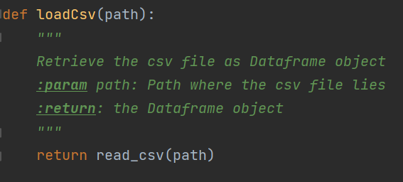
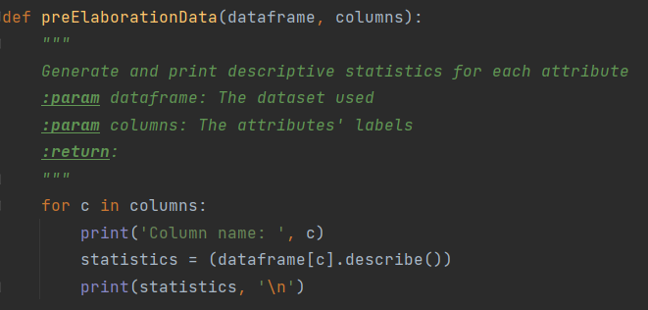
LOADING AND PRE-ELABORATION
Import PANDAS
Load the data => loadCsv
For each independent variable analyze the distribution of the values => preElaborationData

Slide 5
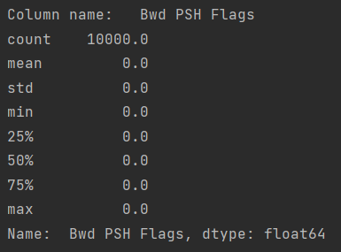
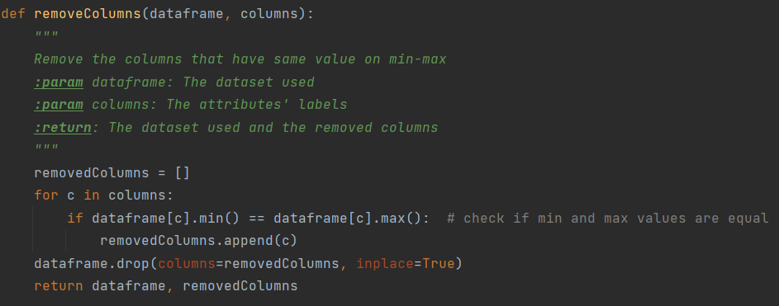
PRE-ELABORATION - RESULTS
Some variables should be removed
Remove the useless variables => RemoveColumns

Slide 6
COLUMNS REMOVED
Removed columns: [' Bwd PSH Flags', ' Fwd URG Flags', ' Bwd URG Flags', 'FIN Flag Count', ' PSH Flag Count', ' ECE Flag Count', 'Fwd Avg Bytes/Bulk', ' Fwd Avg Packets/Bulk', ' Fwd Avg Bulk Rate', ' Bwd Avg Bytes/Bulk', ' Bwd Avg Packets/Bulk', 'Bwd Avg Bulk Rate’]
Dim before the removal | Dim after the removal
(10000, 79) | (10000, 67)

Slide 7
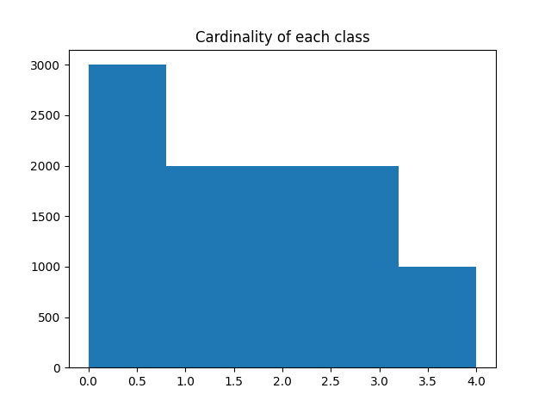
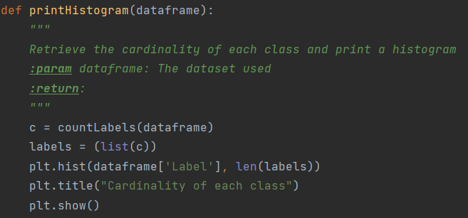
CLASS BALANCING
Histogram of ‘Label’ attribute => printHistogram

Slide 8
DECISION TREE

Slide 9
WHICH PARAMETER?
Parameters
criterion | random_state | ccp_alpha
The function to measure the quality of a split. {“gini”, “entropy”, “log_loss”}, default=”gini” | Controls the randomness of the estimator | Complexity parameter used for Minimal Cost-Complexity Pruning. The subtree with the largest cost complexity that is smaller than ccp_alpha will be chosen

Slide 10
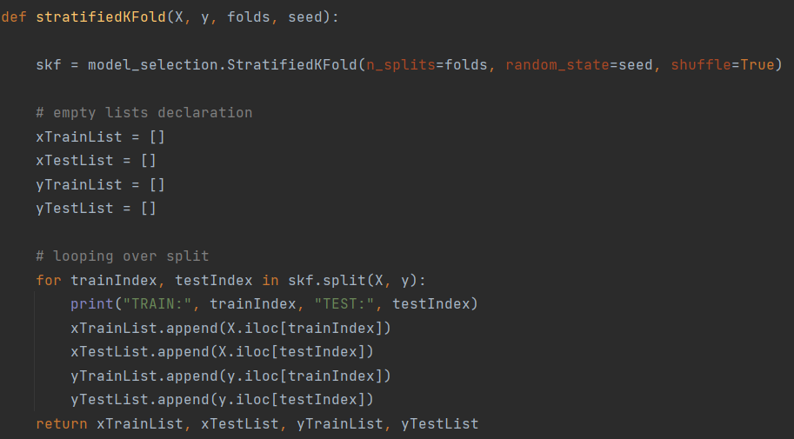

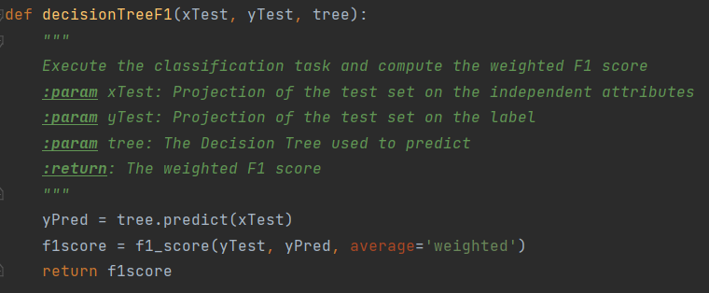
5-FOLD CROSS VALIDATION
Stratified version => stratifiedKFold
Which random_state?
Evaluation metric => decisionTreeF1

Slide 11
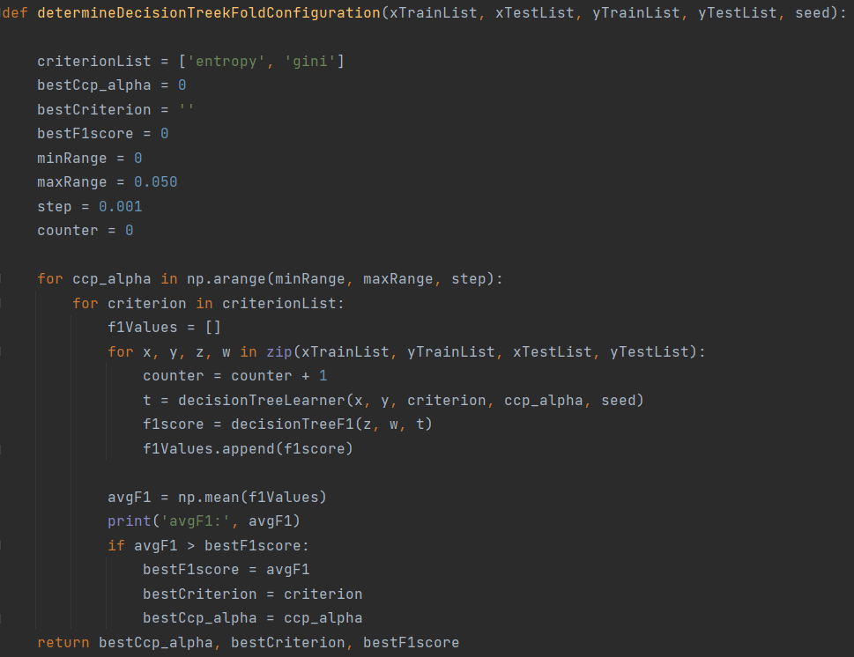
DETERMINING THE BEST PARAMETERS
Using the 5-folds, discover the best configuration, according to the F1score =>determineDecisionTreekFoldConfiguration

Slide 12

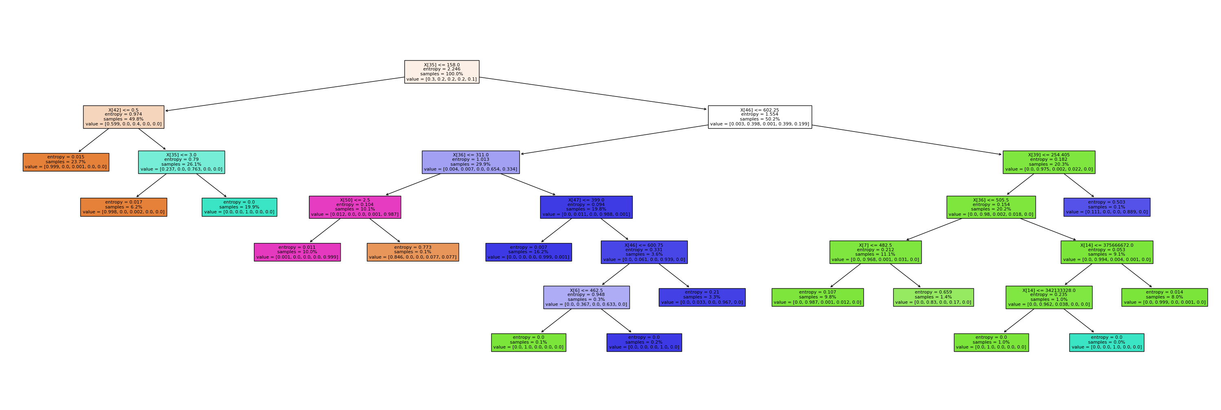
BEST PARAMETERS, BEST TREE
Best parameter obtained:
Best tree:
29 nodes, 15 leaves

Slide 13
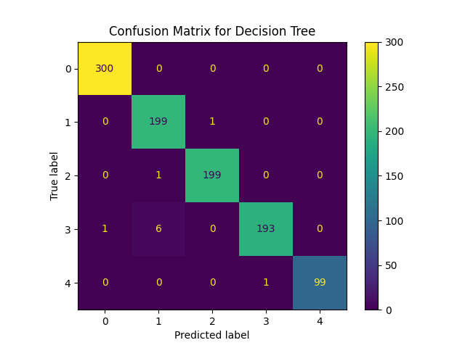
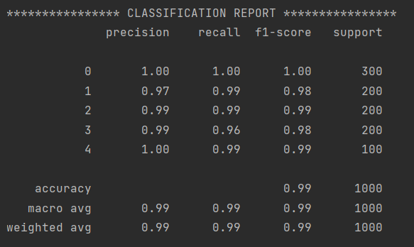
DECISION TREE - EVALUATION
Confusion Matrix
Classification Report

Slide 14
K-MEANS

Slide 15
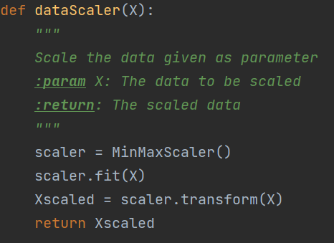
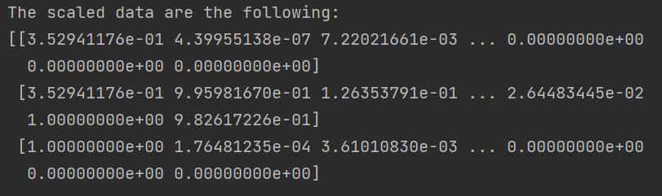
SCALING THE DATA
Scale both Training and Test Set with Min-Max scaling => dataScaler

Slide 16
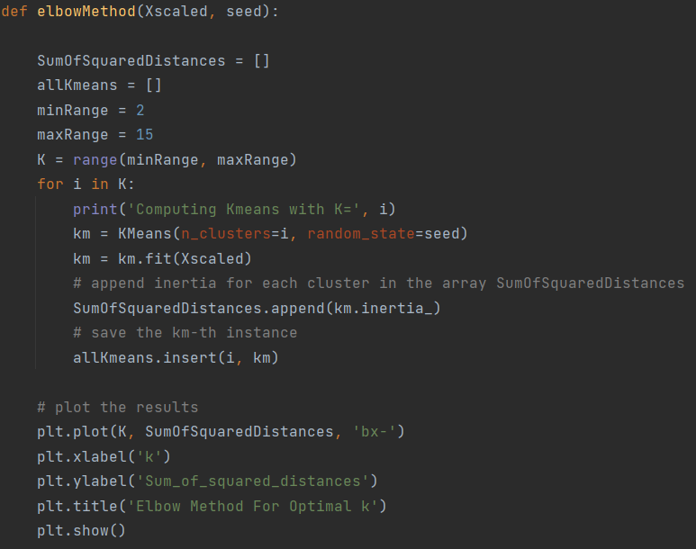
ELBOW METHOD
Exploring the best K => elbowMethod
Evaluation metric: Inertia, that represents the sum of squared distances of samples to their closest cluster center

Slide 17
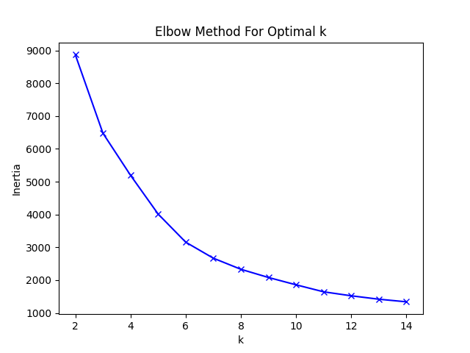
WHICH K?
K = 10

Slide 18
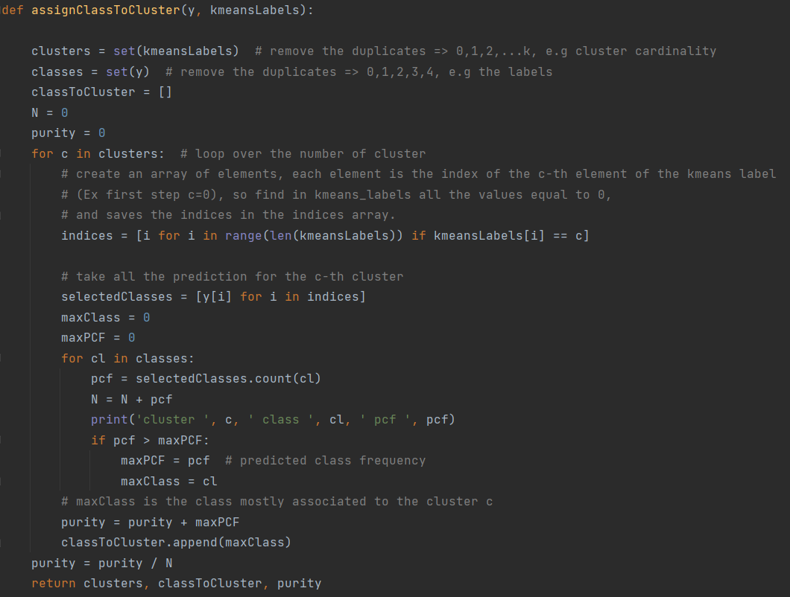

KMEANS FOR CLASSIFICATION
Assign the majority class to each cluster => assignClassToCluster
Evaluation metric: Purity, that is a way to measure the quality of clustering.

Slide 19
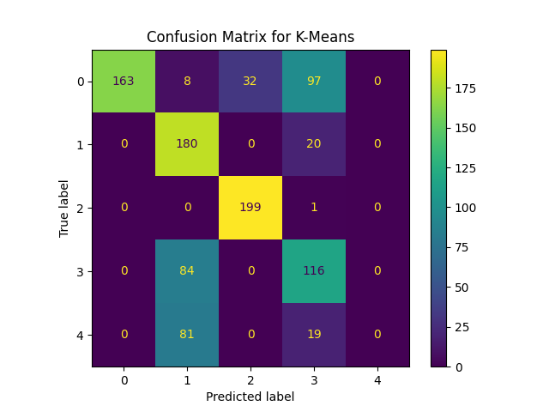
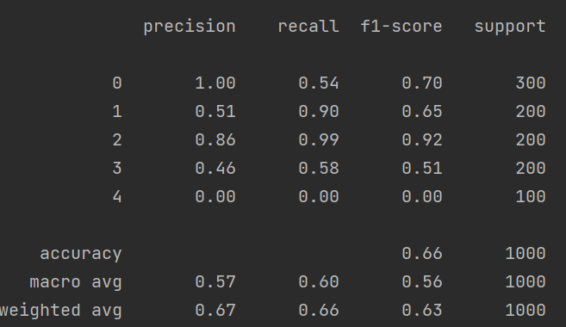
KMEANS - EVALUATION
Confusion Matrix
Classification Report

Slide 20
CONCLUSIONS
Looking at the evaluation results (Confusion Matrices and Classification Reports), Decision Tree performs better then K-Means
For K-Means, the use of a higher value for k (Ex. K=30), we can achieve a significantly better outcome. But increasing the k, we also increase the risk of overfitting the data

Slide 21

THANKS FOR THE AITTENTION
A.A. 2021/2022
Student: Giovanni Forleo

